Slide 1
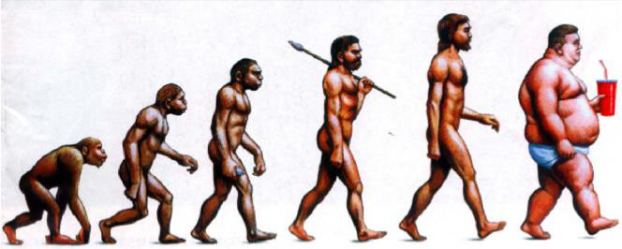
HIGH FRUCTOSE CORN SYRUP

Slide 2
Overview
History and Definition of High Fructose Corn Syrup
Which food products use HFCS?
How is it processed in your body?
Why HFCS is bad for you?
Conclusion

Slide 3
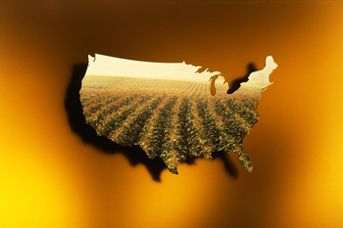
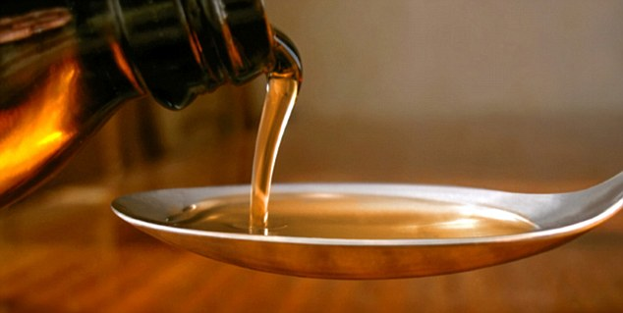
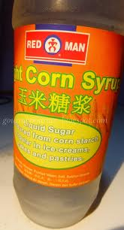
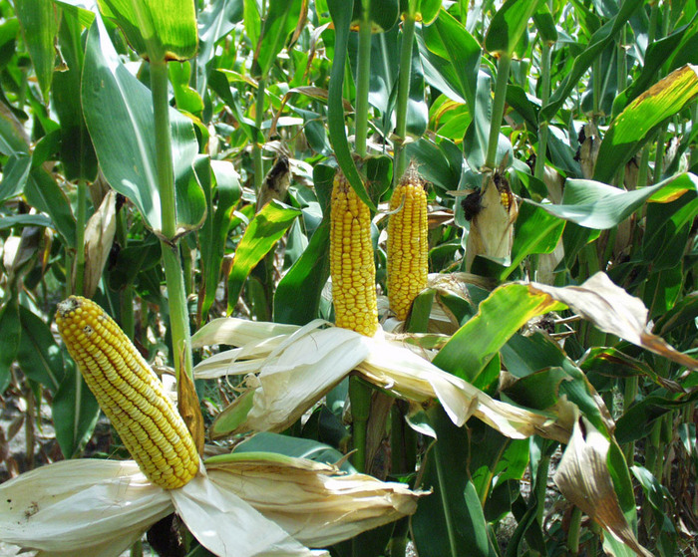
History and Definition of High Fructose Corn Syrup

Slide 4
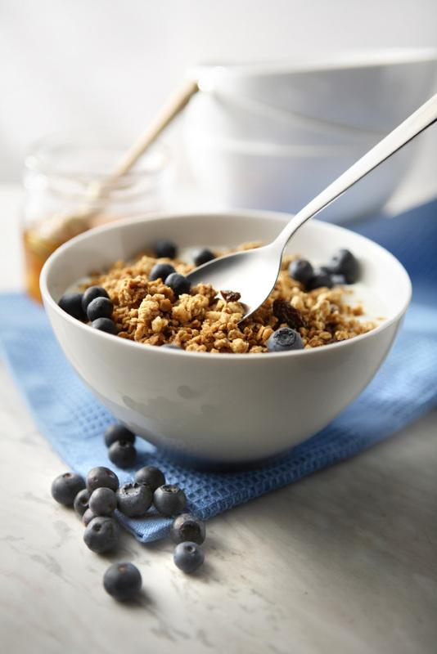
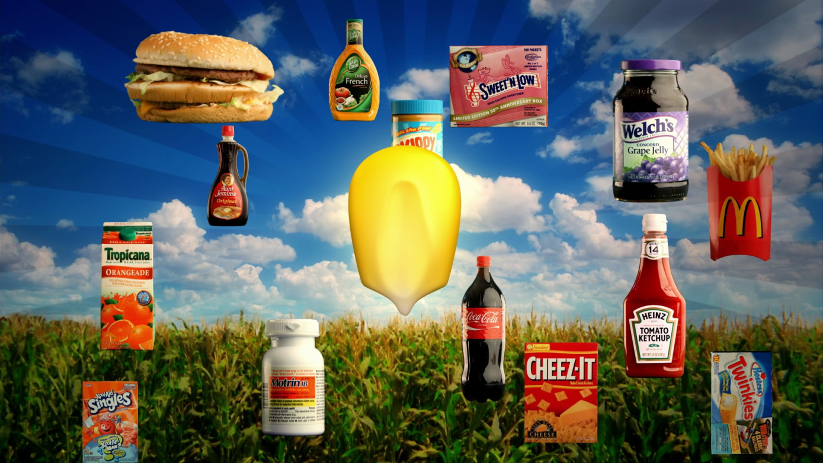
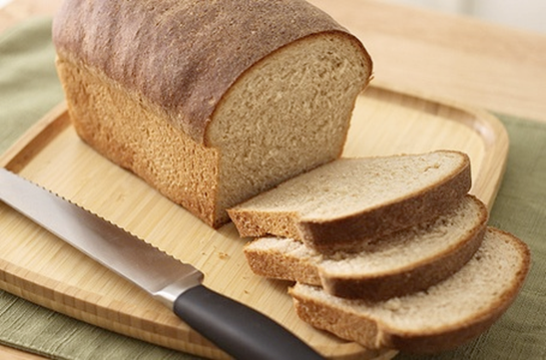
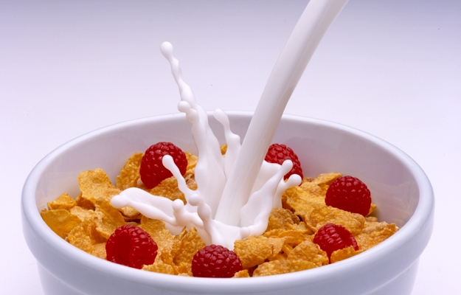
Which food products use HFCS?

Slide 5
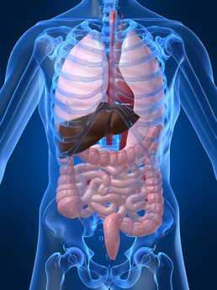
How is it processed in your body?
Your body breaks down HFCS slower than sugar

Slide 6
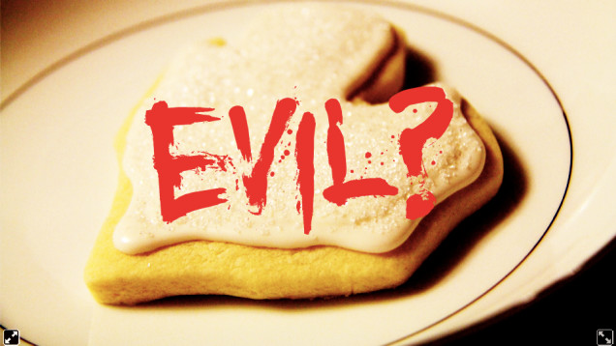
Why HFCS is bad for you?
1. May Cause Diabetes
2. May Make You Obese
3. Can Cause High Blood Pressure

Slide 7
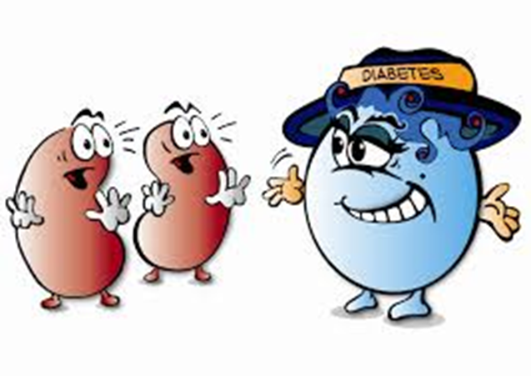
DIABETES

Slide 8
OBESE

Slide 9
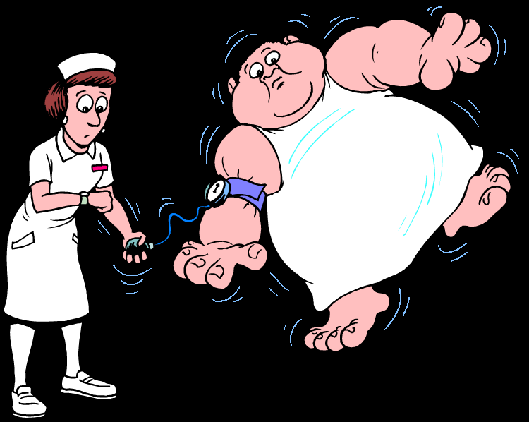
HIGH BLOOD PRESSURE

Slide 10
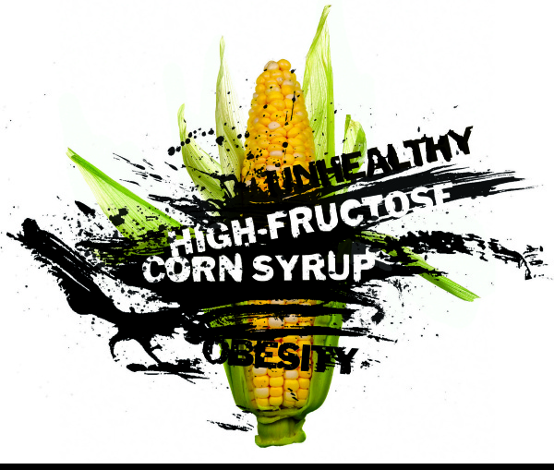
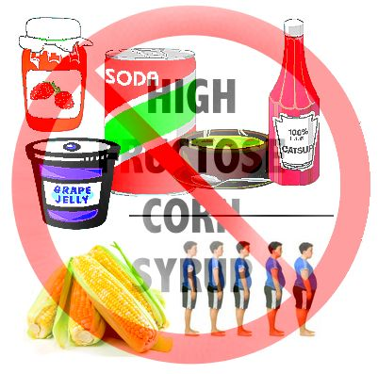
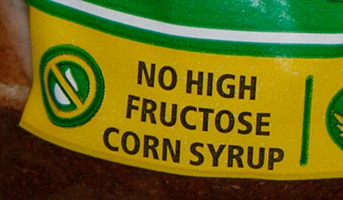
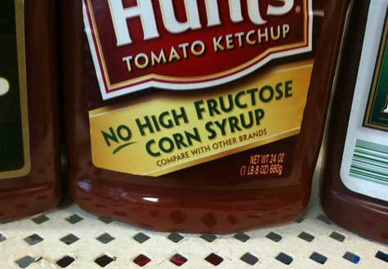
JUST SAY NO TO HIGH FRUCTOSE CORN SYRUP!!!

